Slide 1
Information Search in a Nutshell: Using Data Mining and Science Approaches for Real-World Applications
Oleksandr Krakovetskyi
Software Engineer at The Frayman Group
MCP, Microsoft Regional Director
IT Jam 2010, Kharkiv

Slide 2
Agenda
Information search trends and problems
Intro to Data Mining
Why we need R&D?
Data Mining & information search mixing

Slide 3

Information search
It’s all we do every day!

Slide 4
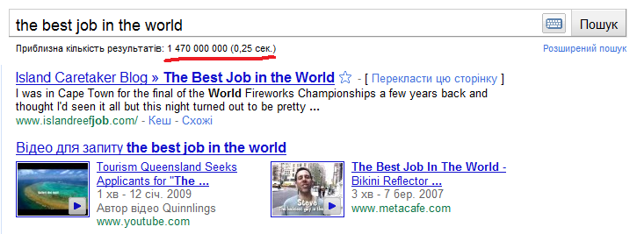
Problem #1: a lot of information

Slide 5
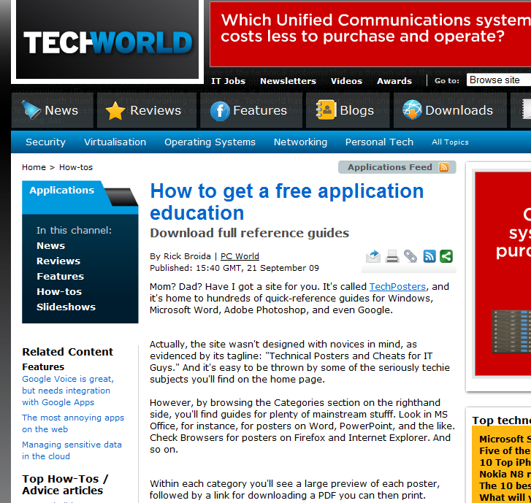
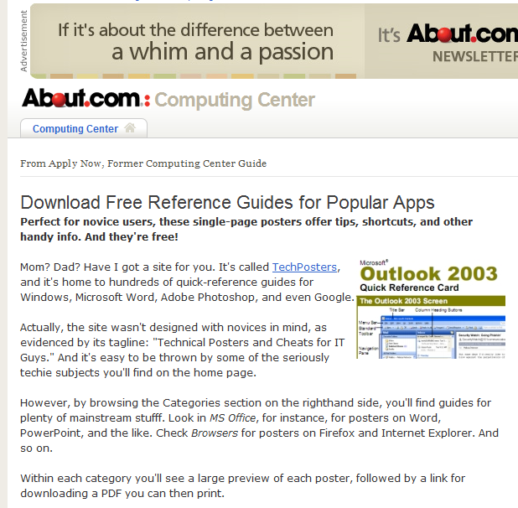
Problem #2: Duplicates

Slide 6
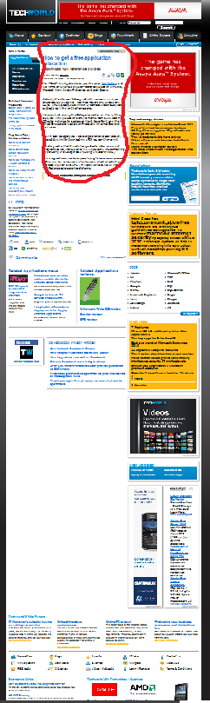
Problem #3: Information waste
We have to look at it!

Slide 7
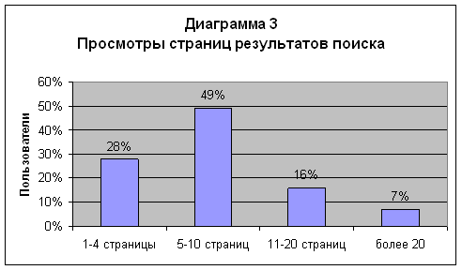
Problem #4: Searching time

Slide 8
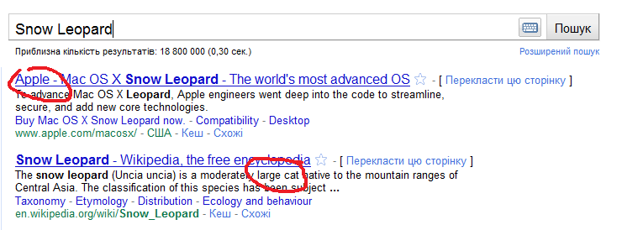
Problem #5: Domain

Slide 9
Hmm, what to do?
Data Mining – intellectual analysis of big amounts of data
clustering, associated rules, GA, Ant optimization, visualization, decision trees, neural networks
R&D – new algorithms, methods and… great experience!
Microsoft Research, Yahoo! Research, Google Labs, Arc90 Lab and others
Let’s mix!

Slide 10
Problem #2: Duplicates
Сравнительный анализ методов определения нечетких дубликатов для Web-документов Зеленков Ю.Г, Сегалович И.В. 2007
Shingles approach:
Text canonization; text partition to shingles; finding checksums; search for identical sub-sequences.
http://www.codeisart.ru/part-1-shingles-algorithm-for-web-documents/

Slide 11
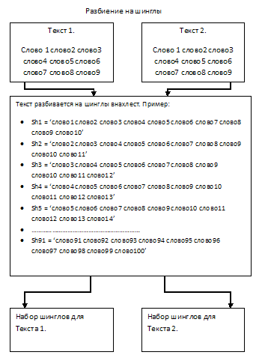
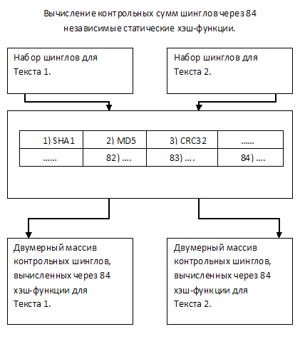
Problem #2: Duplicates /Shingles

Slide 12
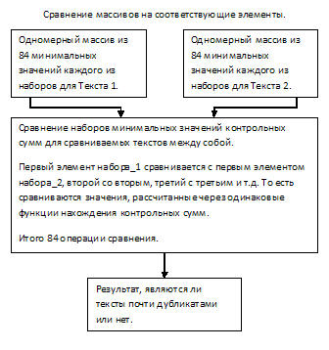
Problem #2: Duplicates /Shingles

Slide 13
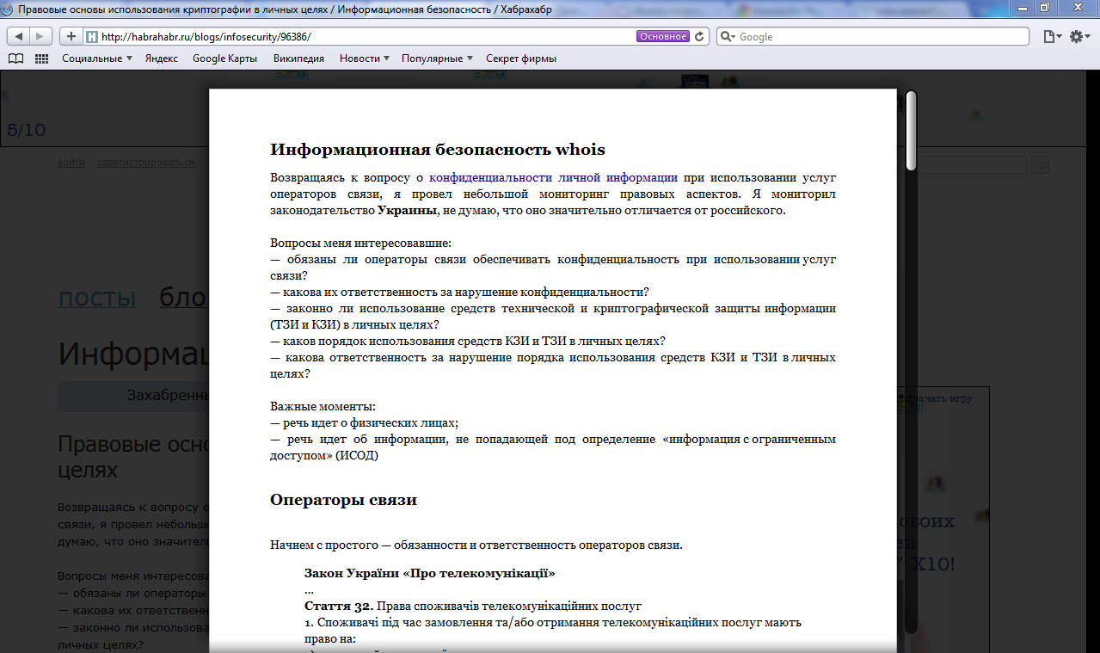
Problem #3: Information waste
Readability / An Arc90 Lab Experiment
Known as Safari Reader

Slide 14
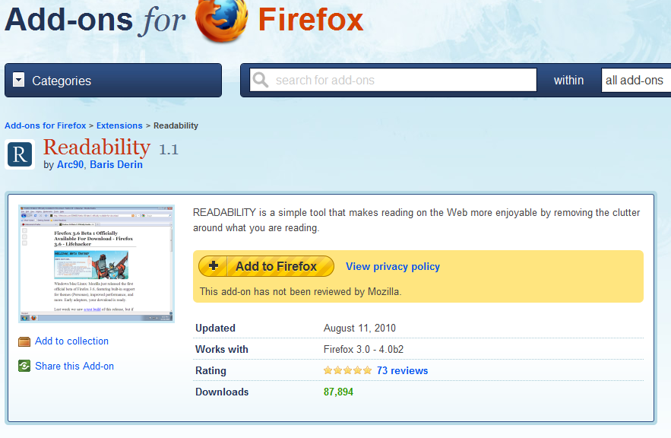
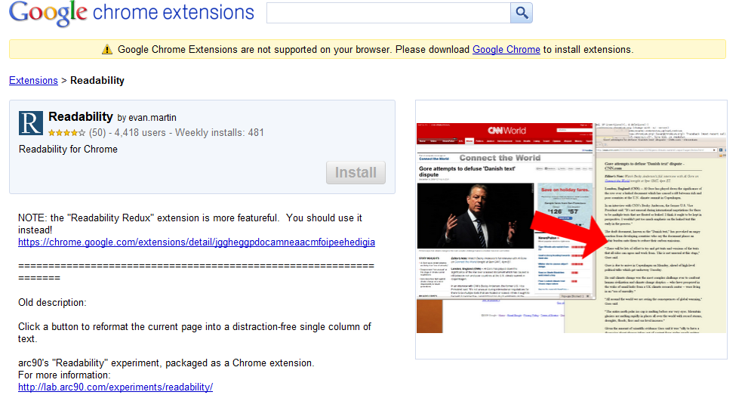
Problem #3: Information waste
Also available as browser add-ons

Slide 15
Problem #3: Information waste
SmartBrowser
http://smartbrowser.codeplex.com/
http://msug.vn.ua/blogs/datamining/archive/2009/04/11/web-page-content-analysis-with-quot-smartbrowser-quot.aspx
http://msug.vn.ua/blogs/datamining/archive/2009/08/06/1010.aspx
http://research.microsoft.com/apps/pubs/default.aspx?id=70027
Критерий SeoRank для определения основного контента веб-страниц
В.М. Дубовой, О.Ю. Краковецький, О.В. Глонь. Факторний аналіз оцінки важливості інформаційних блоків сайтів // Вісник Вінницького політехнічного інституту. - 2008. - №6. - C. 103-107

Slide 16

Problem #3: Information waste
SeoRank
Title 2 text
Meta keywords 2 text
Headers 2 text
Meta description 2 text
WordsIndex, SentencesIndex, WordsInSentencesIndex, LinksIndex, WordsAsLinksIndex, ImgsIndex, ImgsAsLinksIndex, …, ReadabilityScore, SeoRank

Slide 17
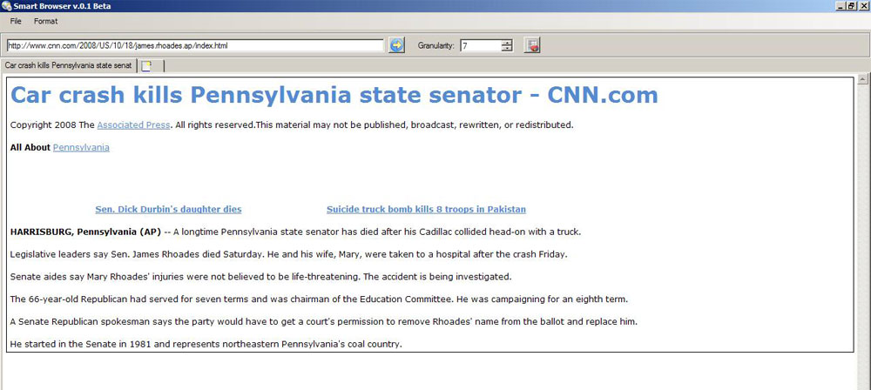
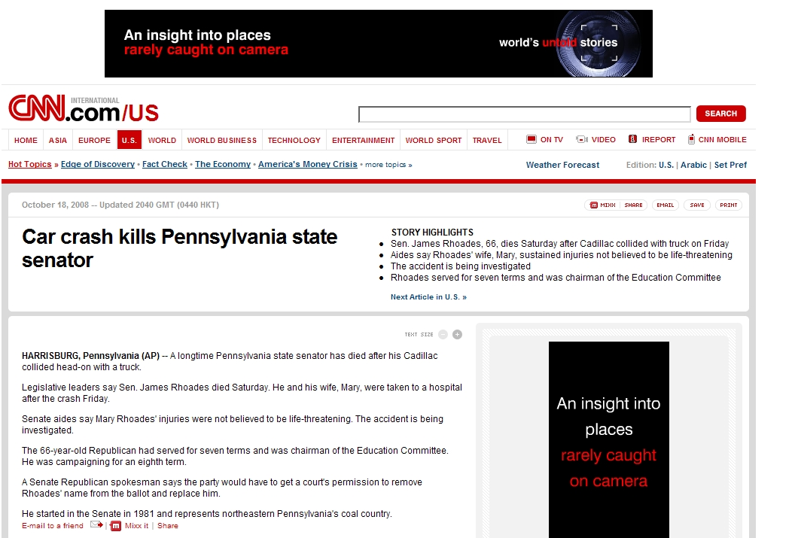
Problem #3: Information waste
Based on
VIPS algorithm
of Microsoft
Research Asia

Slide 18
Problems #4, 5: Searching time
Clustering
Clustering Web Search Results http://medialab.di.unipi.it/web/Search+QA/Seminar/Clustering.ppt
Learning to Cluster Web Search Results
http://research.microsoft.com/pubs/69103/19.pdf
Grouper: A Dynamic Clustering Interface to Web Search Results http://www8.org/w8-papers/3a-search-query/dynamic/dynamic.html
Term Ranking for Clustering Web Search Results http://leo.saclay.inria.fr/events/WebDB2007/Papers/p52.pdf
Clustering Web Search Results Using Suffix Tree Methods http://www.rfreeman.net/wp-content/files/IDEAL06-Freeman.pdf

Slide 19
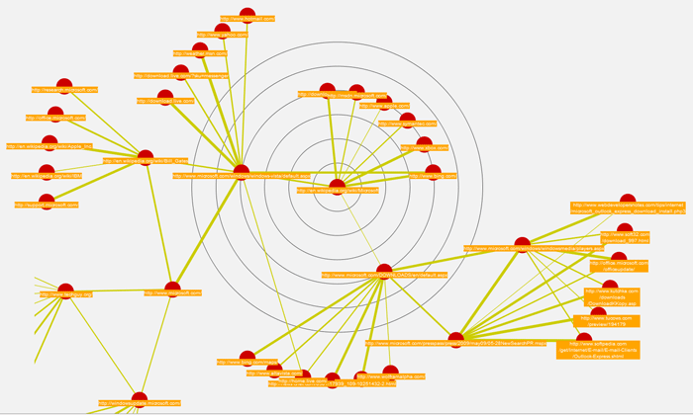
Problem #4: Searching time
Optimal path finding
Об информационном поиске, нахождении оптимальных путей просмотра результатов поиска и многом другом

Slide 20
Trends
Social Search (Facebook, Twitter) and real-time search
“Live” search aka Google
Visualization aka Bing
Expert system aka Wolfram Alpha
Copyright

Slide 21
Real-World Applications
Data Mining system for collecting information about products with clustering
Detecting templates in emails
Automatic creation of object directories such as “world banks” or “all world-wide user groups” etc.
Content management and publishing systems based on non-structured content
Automatic books, feeds creation, syndication by search query or domain
Powerful semantic-based systems
Yours?

Slide 22
References
Data Mining SDK http://datamining.codeplex.com/
Microsoft Research Asia http://research.microsoft.com/en-us/labs/asia/
Information search lectures by Yandex - http://company.yandex.ru/public/seminars/schedule
How Google Works Videos http://bit.ly/bRfUav
How Bing Works http://neotracks.blogspot.com/2009/06/ranknethow-bing-works.html
Data Mining blog at Microsoft User Group Vinnitsya http://msug.vn.ua/blogs/datamining/

Slide 23
Q&A
akrakovetsky@fraymangroup.com

